Slide 1
Linear Discriminant Analysis (LDA)
Fisher Discriminant Analysis

Slide 2
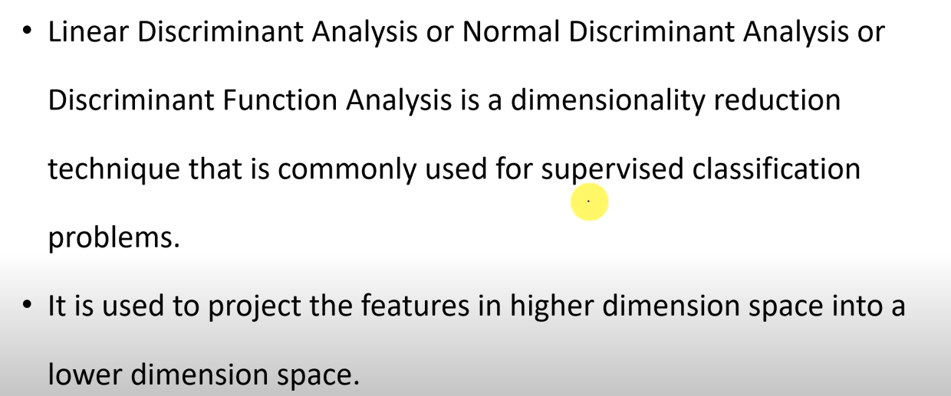
LDA-Introduction

Slide 3
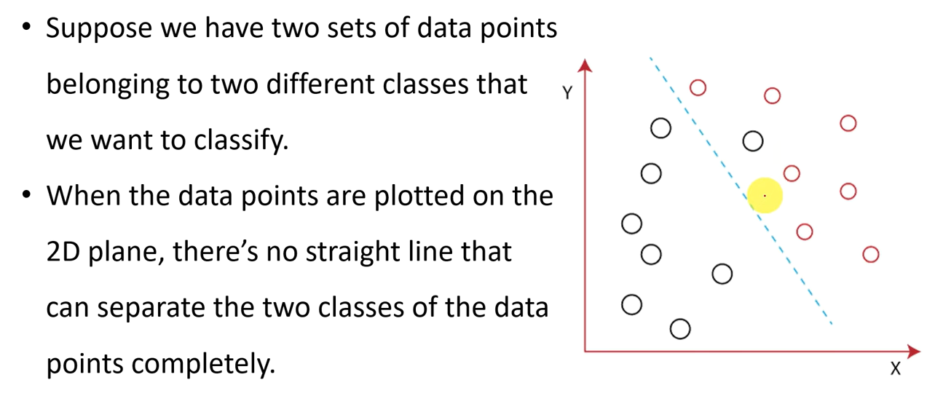
Introduction

Slide 4
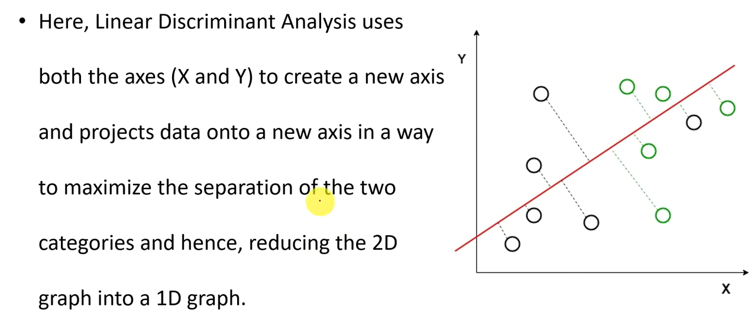
Introduction

Slide 5
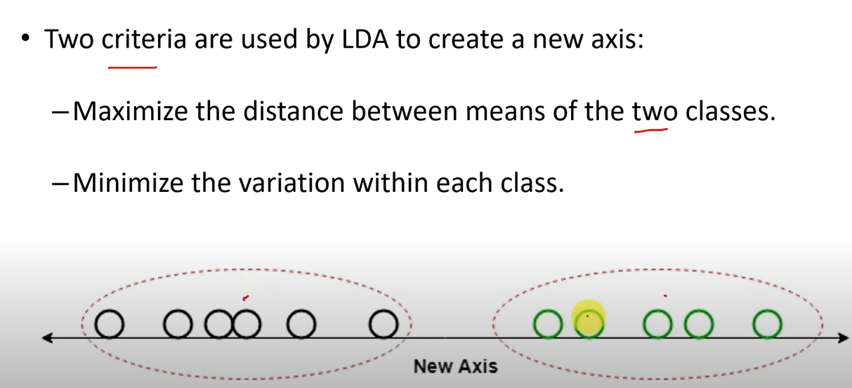
Introduction

Slide 6
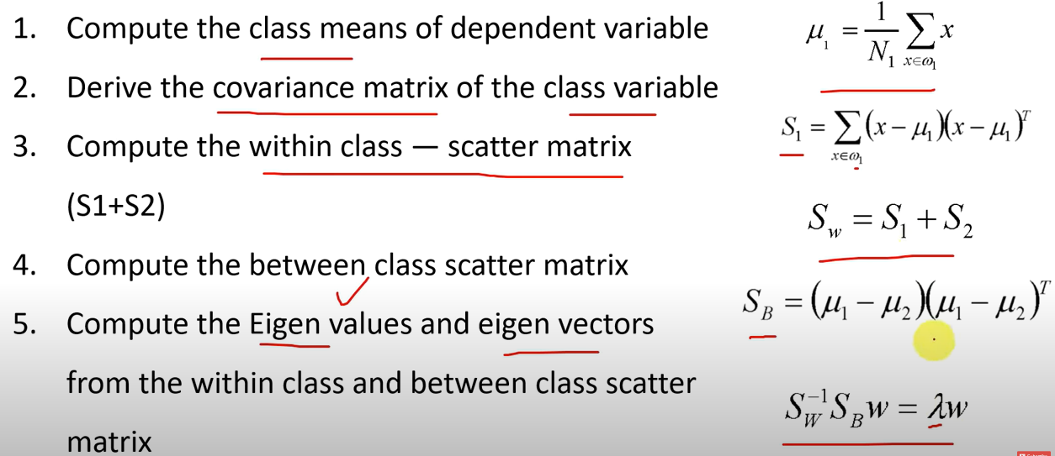
LDA-Steps

Slide 7
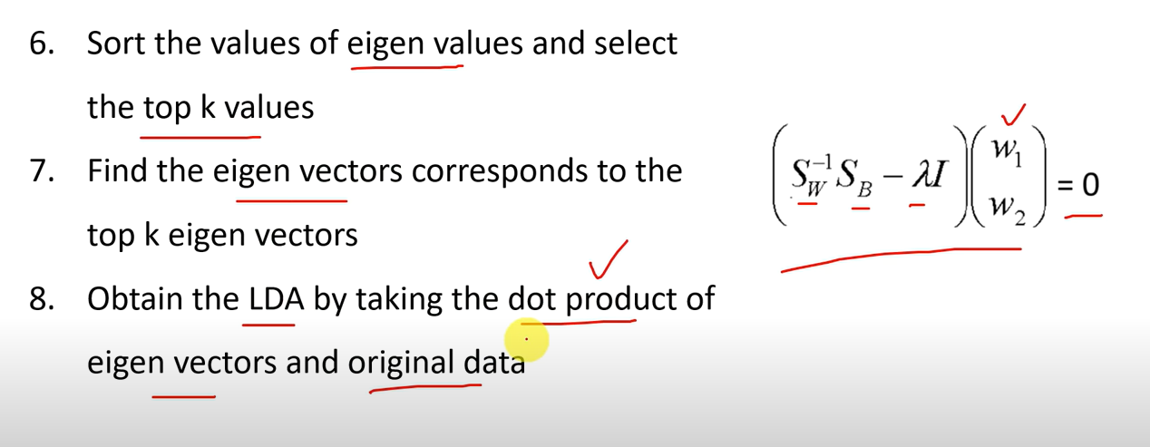
LDA-steps

Slide 8
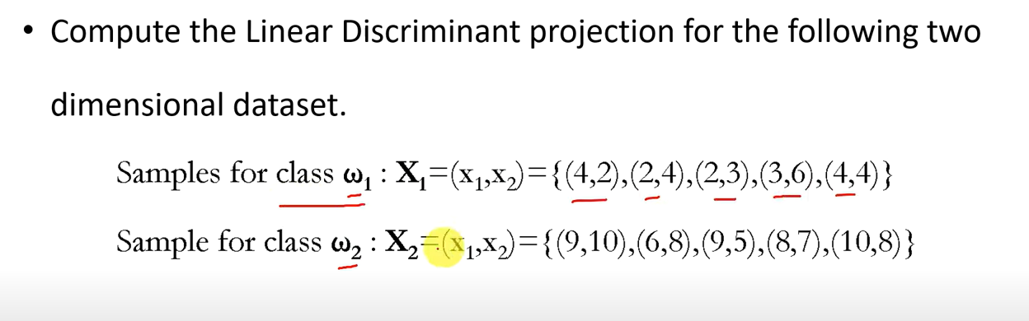
Solved Examples

Slide 9
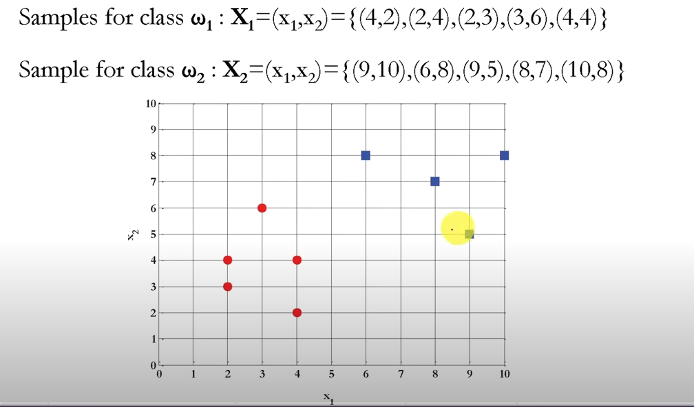
Projection

Slide 10
Calculate Mean

Slide 11
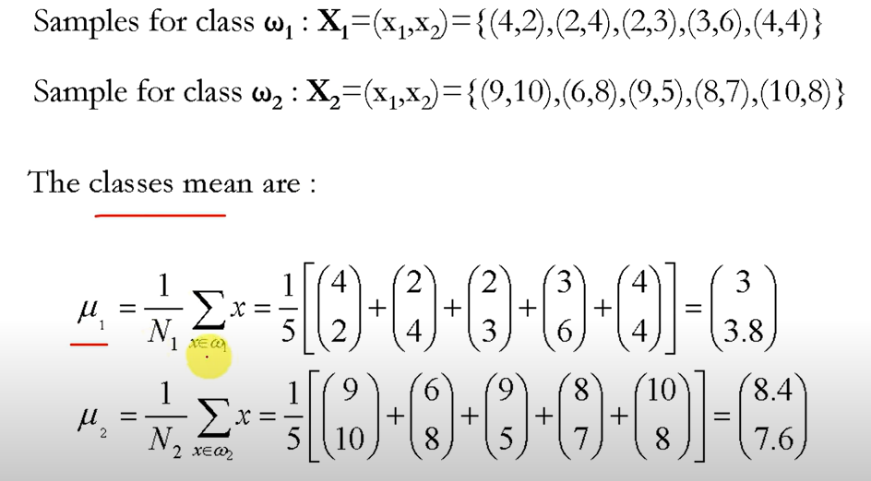
Mean

Slide 12
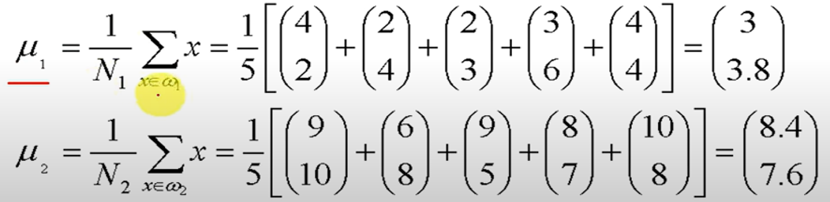
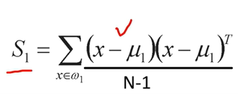
Calculate Covariance(S1)
Mean
Covariance matrix (S1)

Slide 13
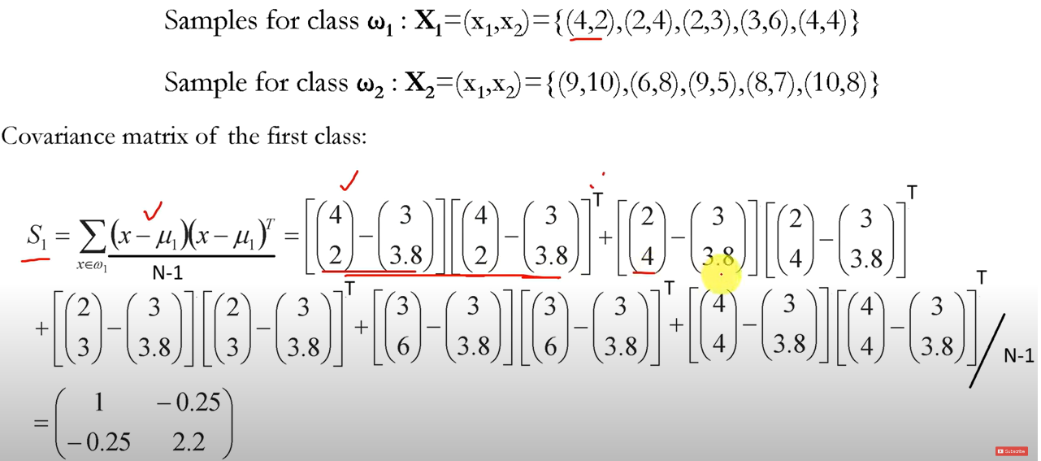
Final Covariance(S1)

Slide 14
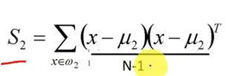
Calculate Covariance(S2)
Mean
Covariance

Slide 15
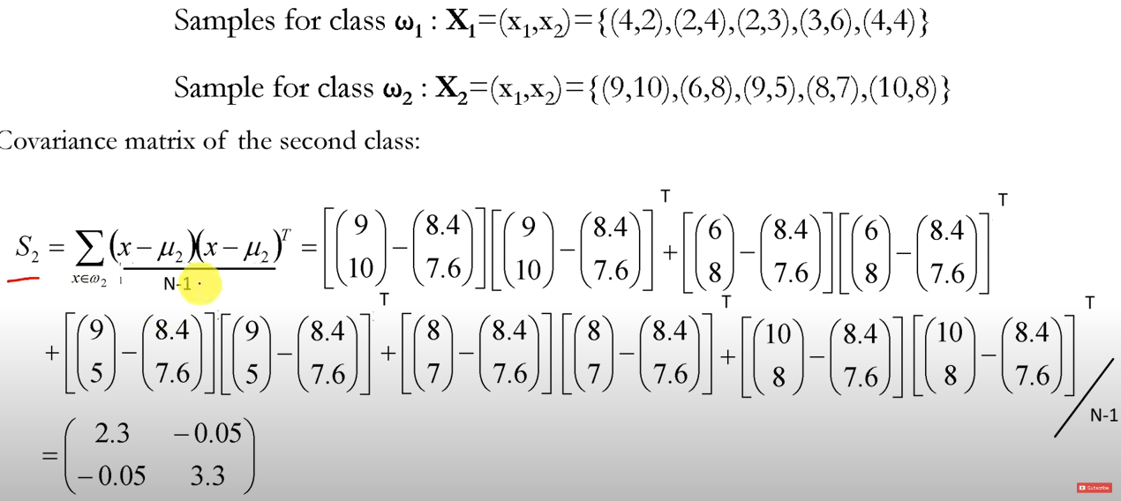
Final Covariance(S2)

Slide 16
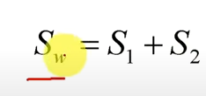
Within Class Scatter matrix

Slide 17
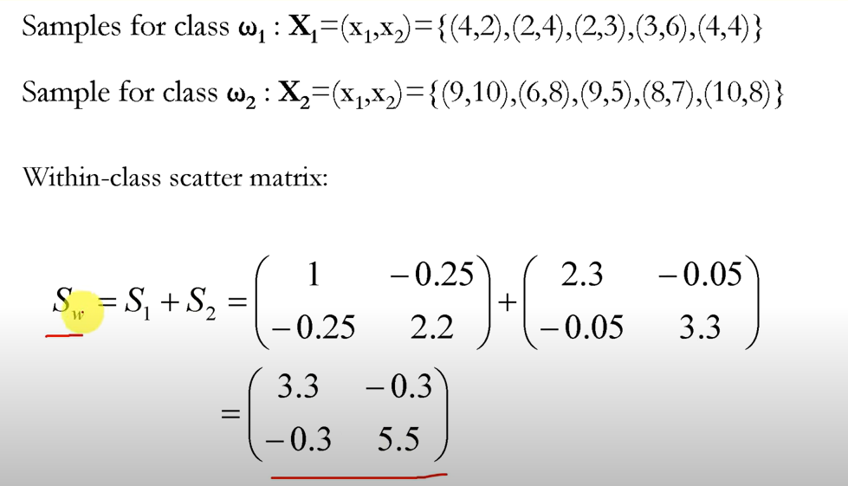
Final Matrix

Slide 18

Between Class Scatter Matrix

Slide 19
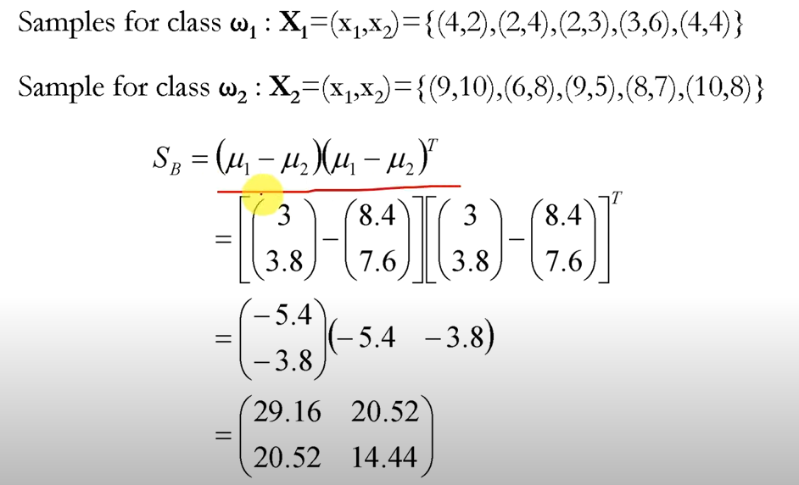
Final SB

Slide 20

Find Eigen Values

Slide 21
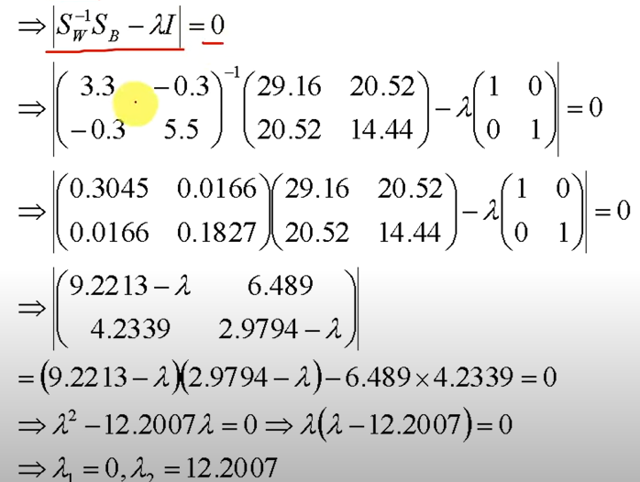
Final Eigen Values

Slide 22
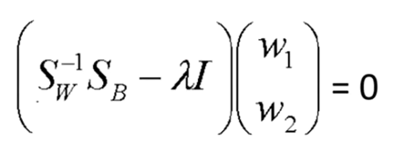
Find Eigen Vector

Slide 23
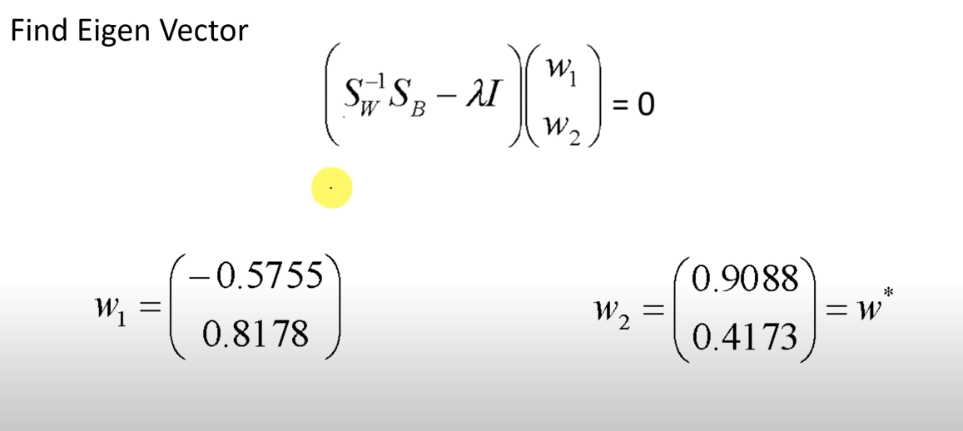
Final Eigen Vector

Slide 24
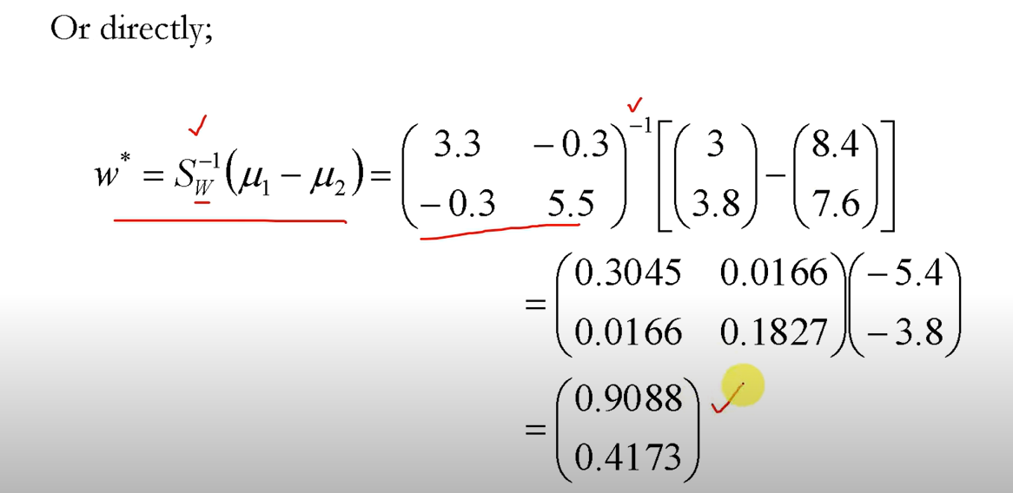
Direct

Slide 25
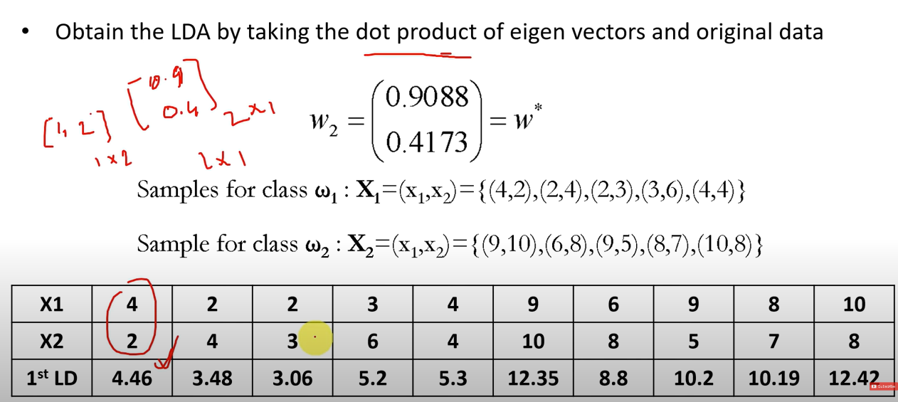

Slide 26
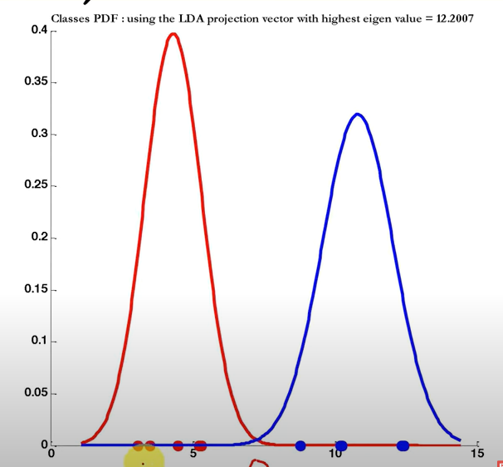
Final projection

